Slide 1
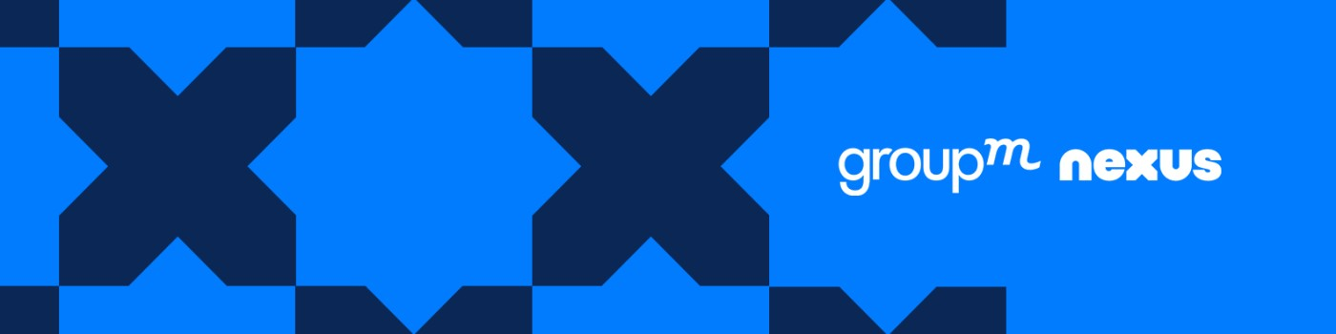
Internship at GroupM Nexus
R Vivek ( 12204878 ) Jan’ 2024 – July 2024

Slide 2
Agenda
Introduction – About GroupM Nexus
- About parent Company
Project Overview
Learnings & Reflections
Termologies

Slide 3
Introduction

Slide 4
GroupM Nexus
GroupM Nexus Commerce serves as a centralized hub for commerce intelligence, encompassing strategy, media activation, creative, data, and technology across retail, direct-to-consumer, and social commerce. Their mission is to optimize advertising campaigns, making them more efficient and impactful for consumers, supported by cutting-edge technology and artificial intelligence.

Slide 5
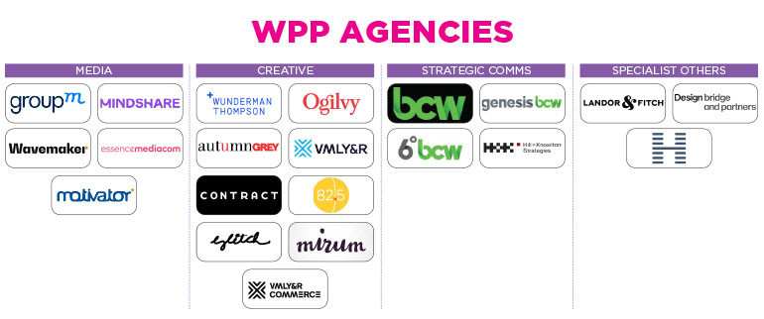

Slide 6
Learnings & Reflections

Slide 7
Learnings & Reflections
Backend Development Using Python and Javascript
Automation and Integration (Power Automate)
Power Query

Slide 8
Backend Development Using Python And Javascript

Slide 9
Backend Development
Python for API Backend Development: Python is widely used for backend API development due to its simplicity and readability. Frameworks like Django and Flask provide powerful tools for building robust and scalable APIs.
Node.js for API Backend Development: Node.js is a JavaScript runtime built on Chrome's V8 engine. Frameworks like Express.js facilitate the development of APIs by providing a minimal and flexible set of features for web and mobile applications. Node.js is particularly popular for its performance, scalability, and the ability to use the same language (JavaScript) for both frontend and backend development.

Slide 10
RPA- Robotic Process Automation

Slide 11
What is RPA?
RPA (Robotic Process Automation) enables users to program software bots to execute instructions, utilizing automation, computer vision, and machine learning for repetitive, rule-based tasks triggered by predefined events.
In the digital advertising industry, tasks like data entry, report generation, and campaign optimization are automated by RPA, reducing human error and accelerating processes for faster and accurate data analysis.

Slide 12
Power Query

Slide 13
What is Power Query?
Data Connection and Transformation Tool: Power Query is a data connection technology that allows users to discover, connect, combine, and refine data across a wide variety of sources. It is integrated into several Microsoft products like Excel and Power BI, enabling users to import data from databases, online services, files, and other sources, and then transform it through a user-friendly interface without the need for complex programming.
Automated and Repeatable Processes: With Power Query, users can automate data preparation tasks, creating repeatable and shareable processes. It allows for the cleaning, reshaping, and merging of data through a series of applied steps, which can be easily modified and updated as needed, ensuring data consistency and saving time on manual data manipulation.

Slide 14
Projects

Slide 15
Creation of Database in Google Cloud Platform

Slide 16
Creation of Database in Google Cloud Platform
Process Flow
Data Extraction from DV360, Amazon Ads, Salesforce and TradeDesk.
Dashboard Creation on Looker Studio
Loading Data into Google BigQuery
(Data Warehouse)
Performing mapping, transformation, and processing
Google cloud functions
and scheduler
Data source
Dashboard creation on Looker Studio

Slide 17
Automation of Excel Reporting

Slide 18
Creation of Database in Google Cloud Platform
Process Flow
Data Extraction from DV360, Amazon Ads, Salesforce and TradeDesk.
Dashboard Creation on Looker Studio
Loading Data into Google BigQuery
(Data Warehouse)
Performing mapping, transformation, and processing
Google cloud functions
and scheduler
Data source
Dashboard creation on Looker Studio

Slide 19
Tools & Terminologies

Slide 20
1. Google Cloud Platform (GCP): Foundation for hosting ETL pipeline components, offering cloud services for data processing, storage, and analytics at scale.
External APIs (Amazon Ads, DV360, Salesforce and TradeDesk): Accessed by pipelines for fetching data, processed in structured formats like CSV.
Google BigQuery: Serverless data warehouse for storing and managing processed data after transformation.
Looker Studio / Power BI: Data visualization and analytics platform connecting to Google BigQuery for creating dashboards and reports.
Google Cloud Functions: Serverless computing service acting as ETL/ELT orchestrator, making API requests to fetch data from external sources.
Google Cloud Scheduler: Managed cron job service scheduling recurring tasks to trigger Cloud Functions.
Python SDK : It is used for creating the API and cleansing of the data.

Slide 21
Thank you

